Slide 1




Commodity
Machine Learning
importamueller@gmail.com
@t3kcit
@amueller
peekaboo-vision.blogspot.com
Andreas Müller
Amazon, scikit-learn

Slide 2

To Apply Machine Learning!

Slide 3
What ML can do for you

Slide 4
Hi Andy,
I just received an email from the first tutorial speaker, presenting right before you, saying he's ill and won't be able to make it.
I know you have already committed yourself to two presentations, but is there anyway you could increase your tutorial time slot, maybe just offer time to try out what you've taught? Otherwise I have to do some kind of modern dance interpretation of Python in data :-)
-Leah
Classification
Hi Andreas,
I am very interested in your Machine Learning background. I work for X Recruiting who have been engaged by Z, a worldwide leading supplier of Y. We are expanding the core engineering team and we are looking for really passionate engineers who want to create their own story and help millions of people.
Can we find a time for a call to chat for a few minutes about this?
Thanks

Slide 5
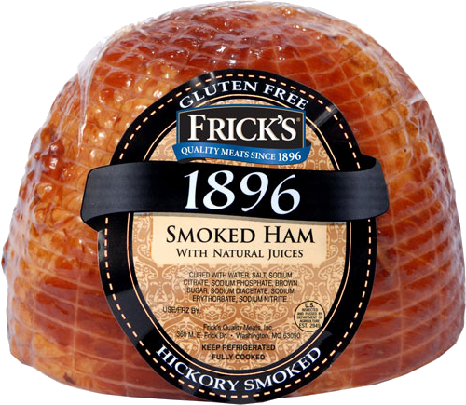
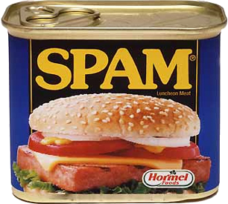
Hi Andy,
I just received an email from the first tutorial speaker, presenting right before you, saying he's ill and won't be able to make it.
I know you have already committed yourself to two presentations, but is there anyway you could increase your tutorial time slot, maybe just offer time to try out what you've taught? Otherwise I have to do some kind of modern dance interpretation of Python in data :-)
-Leah
Classification
Hi Andreas,
I am very interested in your Machine Learning background. I work for X Recruiting who have been engaged by Z, a worldwide leading supplier of Y. We are expanding the core engineering team and we are looking for really passionate engineers who want to create their own story and help millions of people.
Can we find a time for a call to chat for a few minutes about this?
Thanks

Slide 6
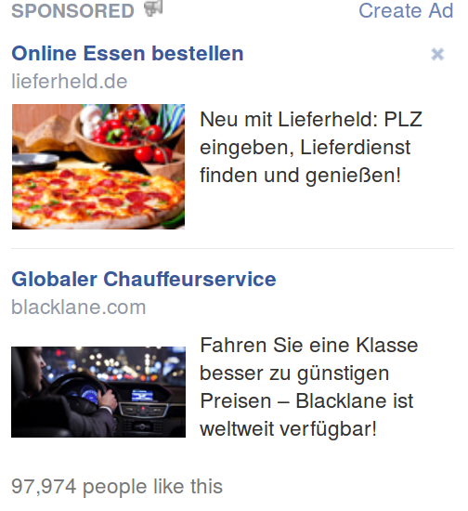
Classification

Slide 7
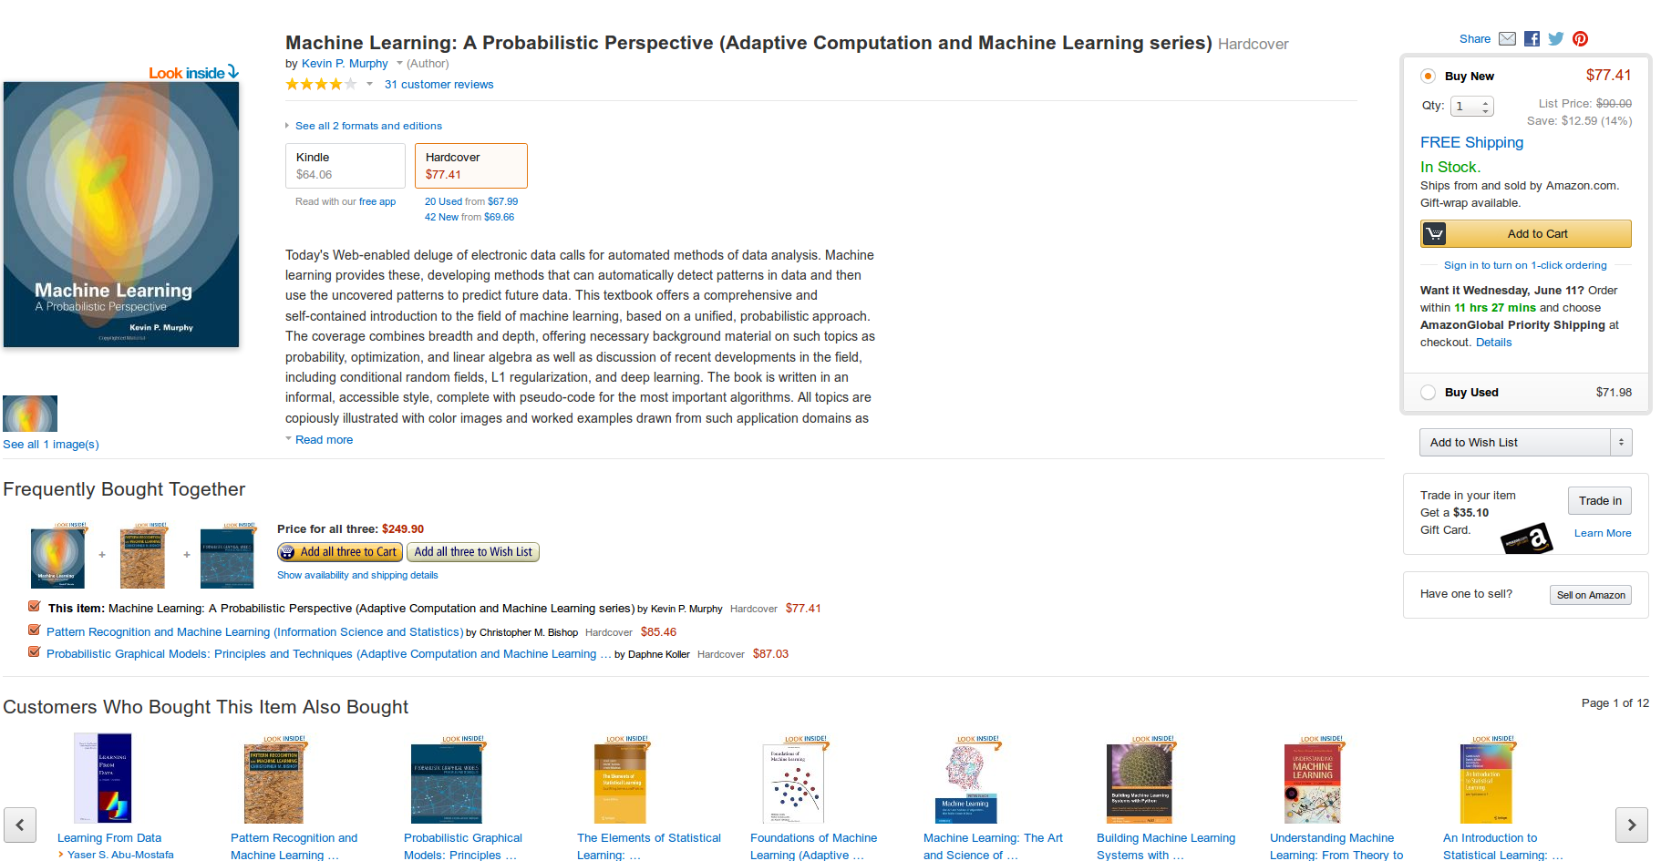
Recommendations

Slide 8
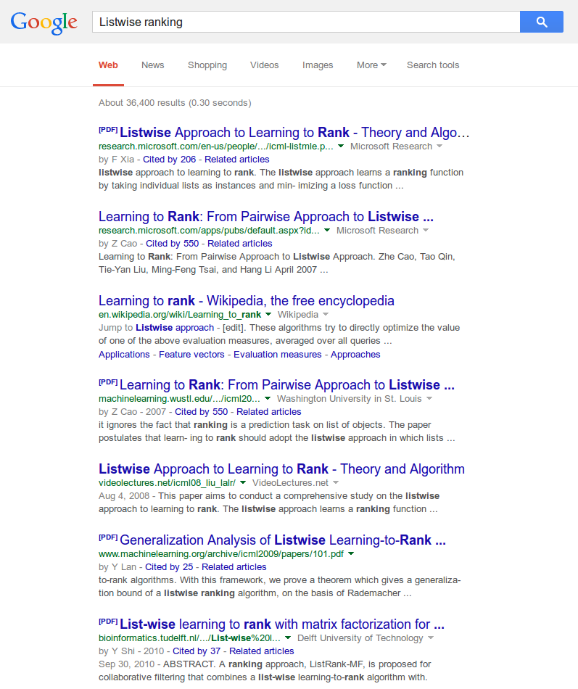
Ranking

Slide 9
Applying machine learning is easy.

Slide 10
Applying machine learning is easy.
But it should be easier!

Slide 11




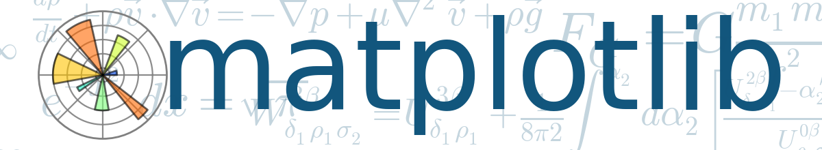



Slide 12
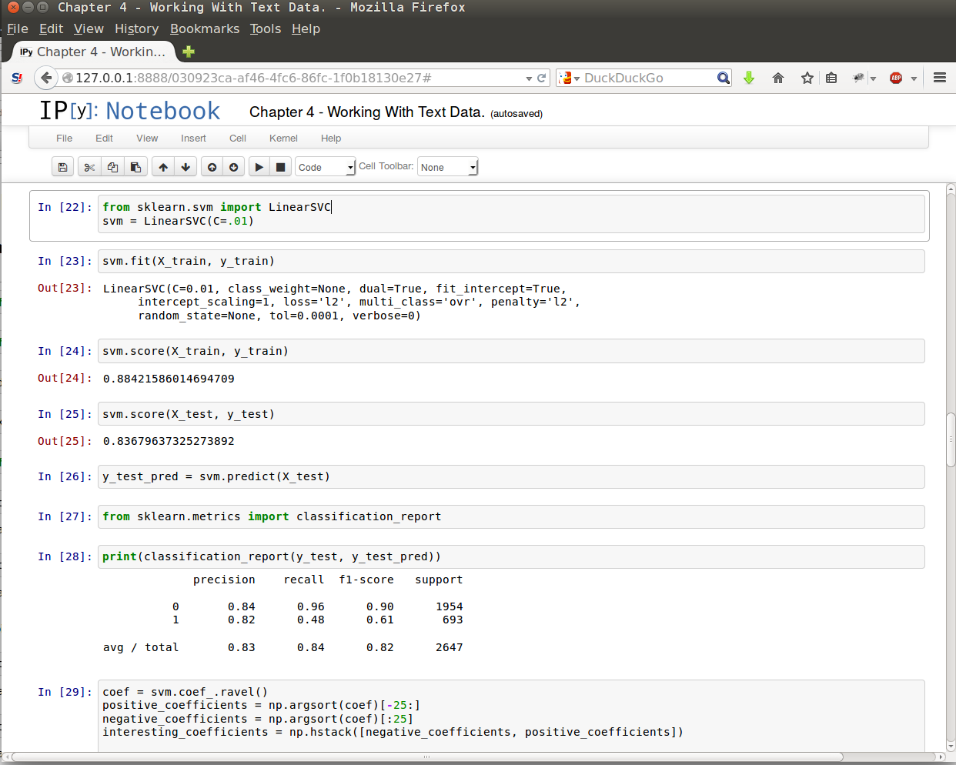
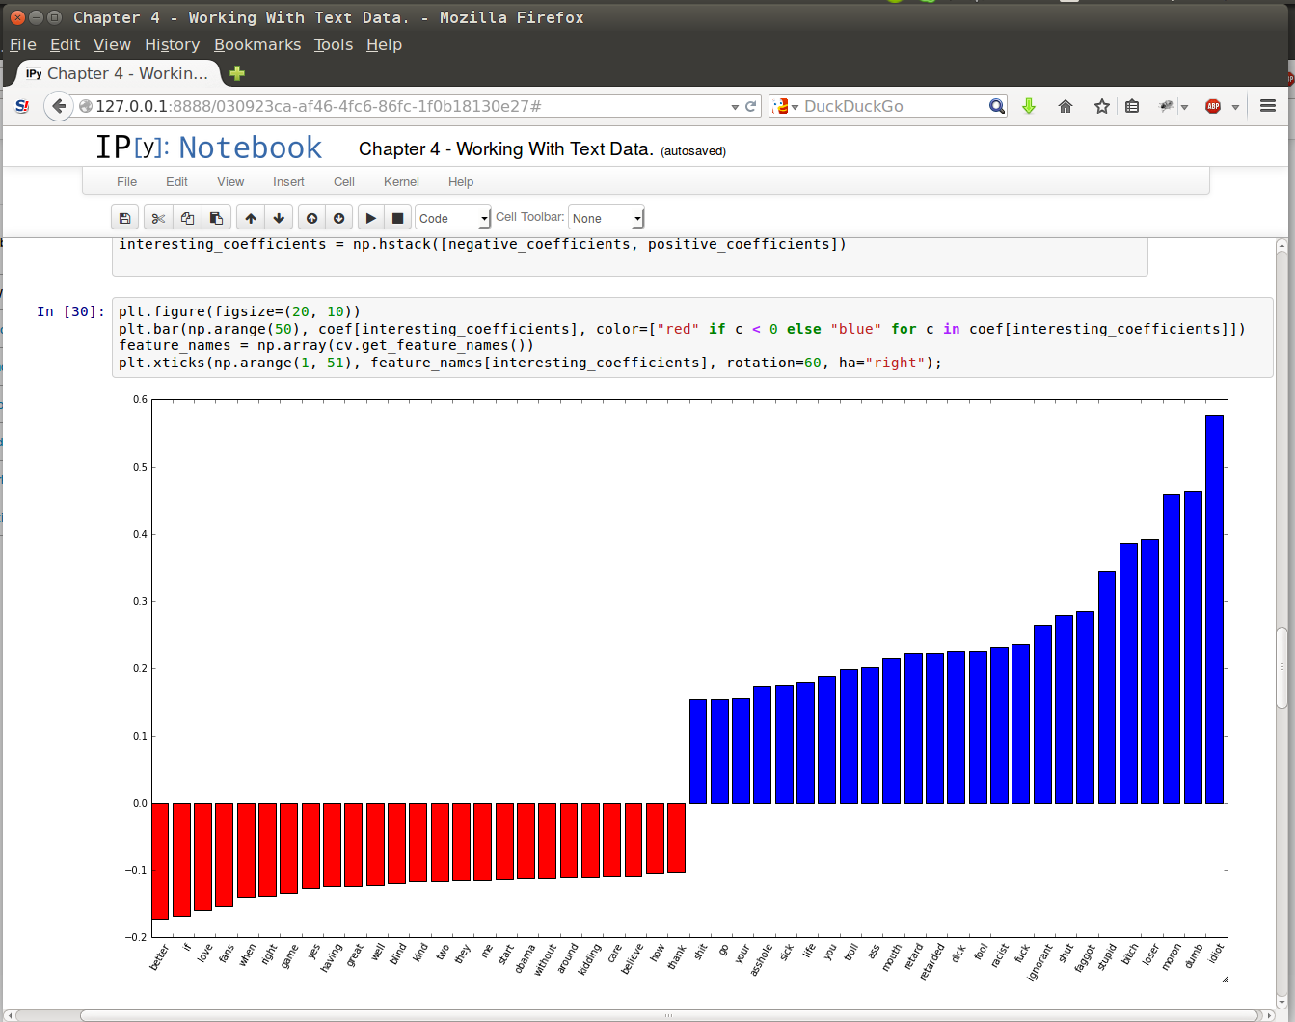

Slide 13
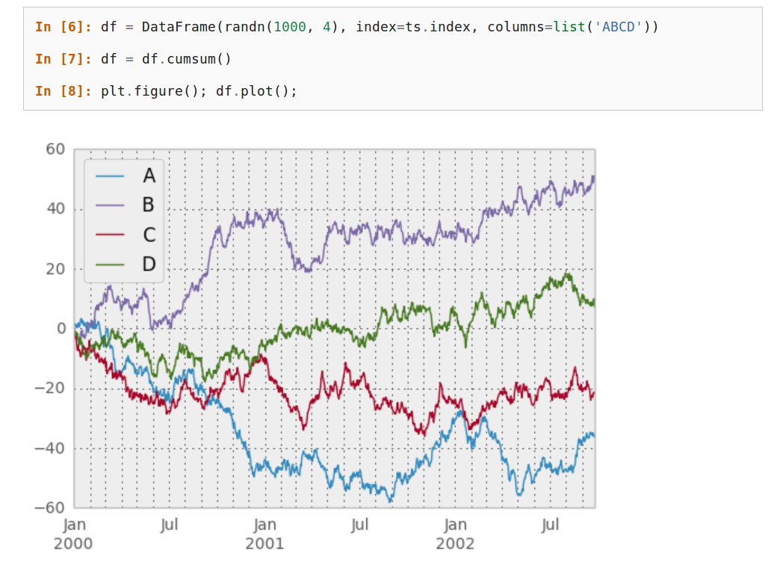

Slide 14
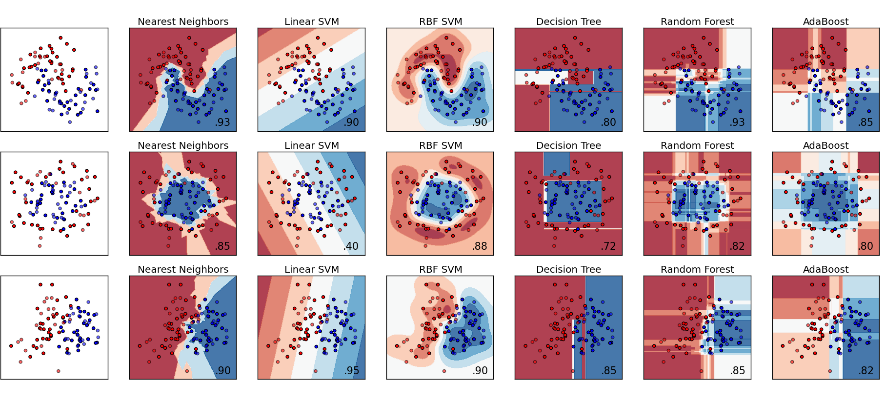

Slide 15








500+ research papers

Slide 16
from sklearn.ensemble import RandomForestClassifier
clf = RandomForestClassifier()
clf.fit(X_train, y_train)
clf.predict(X_test)

Slide 17
Fully Functional Spam Classifier
from sklearn.naive_bayes import MultinomialNB
from sklearn.feature_extraction.text import CountVectorizer
from pipeline import make_pipeline
spam_classifier = make_pipeline(CountVectorizer(),
MultinomialNB())
spam_classifier.fit(email_texts, is_spam)
spam_classifier.predict(new_emails)

Slide 18
Generalized Linear Models
Support Vector Machines
Stochastic Gradient Descent
Nearest Neighbors
Gaussian Processes
CCA
Naive Bayes
Decision Trees
Ensemble methods
Multiclass and multilabel algorithms
Clustering
Matrix Factorization
Manifold Learning
Mixture Models

Slide 19
“The scikit-learn tutorials / documentation is so good, one doesn't need a textbook anymore to learn a new machine learning method.”

Slide 20
This is not enough!

Slide 21
Automation /
Expertise needed
Data size

Slide 22
Automation /
Expertise needed
One Click
Library
Data size
Fits in Ram
Single Machine
Infinitely scalable

Slide 23


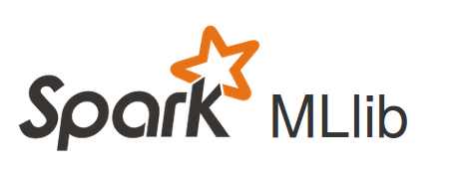
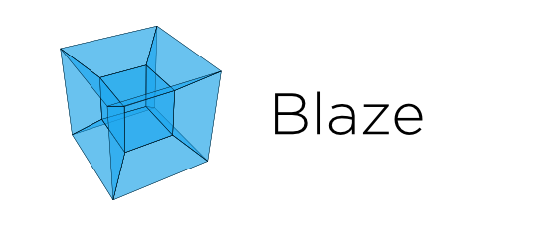
Automation /
Expertise needed
One Click
Skll
Azure ML
Library
Data size
Fits in Ram
Single Machine
Infinitely scalable

Slide 24
Why a single machine is (usually) enough

Slide 25
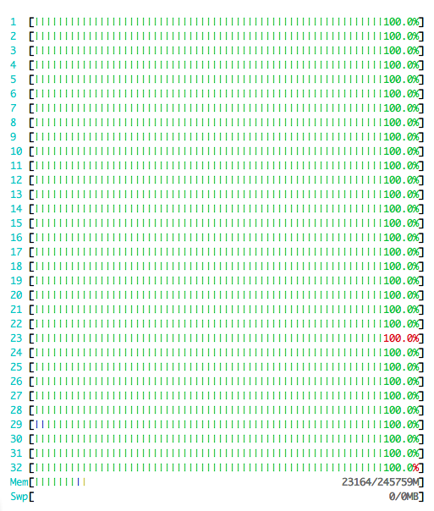

Slide 26
Smart, not Big

Slide 27
Why we need open box methods

Slide 28
Why we need black-box methods

Slide 29
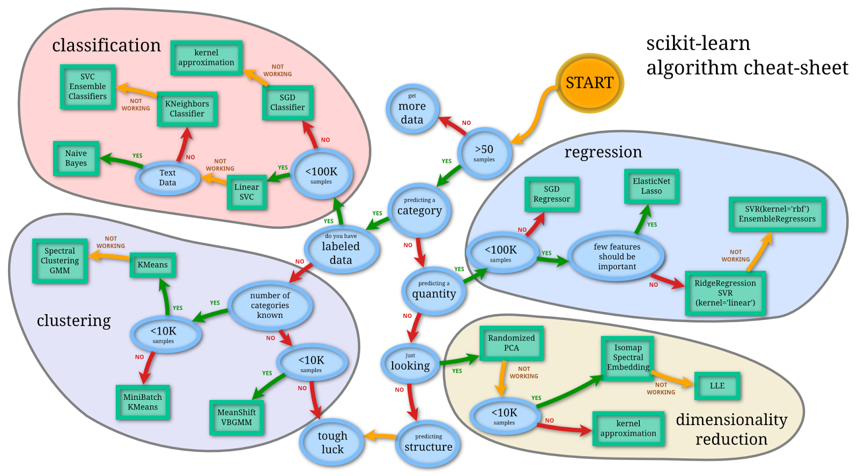

Slide 30

predict

Slide 31
Hyperparameter Optimization
Spearmint
Hyperopt
smac

Slide 32
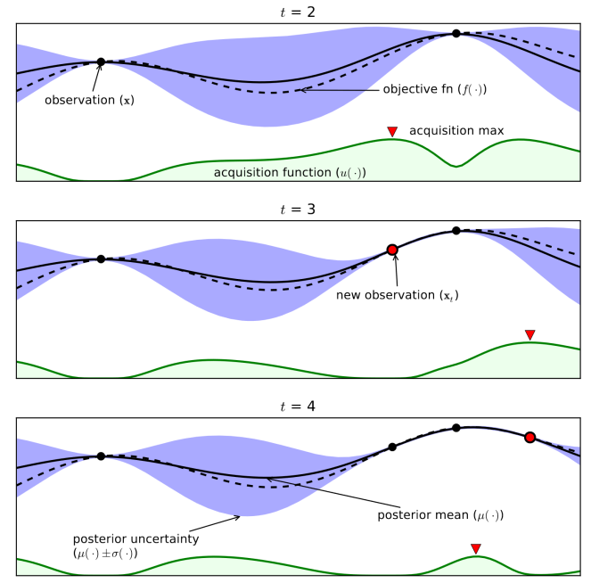
Bayesian Optimization
From Eric Brochu, Vlad M. Cora and Nando de Freitas

Slide 33
Why we need to scale beyond a single machine

Slide 34
Automation /
Expertise needed
One Click
Skll
Azure ML
Library
Data size
Fits in Ram
Single Machine
Infinitely scalable

Slide 35



Automation /
Expertise needed
One Click
Skll
Azure ML
Library
Data size
Fits in Ram
Single Machine
Infinitely scalable

Slide 36
Thank you.
importamueller@gmail.com
@t3kcit
@amueller
peekaboo-vision.blogspot.com
Andreas Müller

